Slide 1
KHCC FlexDashboard
A research study authorized by KHCC IRB (22 KHCC 128)
Aims to enhance clinical research by providing investigators an opportunity to review our cancer registry quickly and do statistical analysis
Password access can be providing after emailing the PI
Interpretation of results is the responsibility of the investigator
Please cite us if you use the tool
PI: Dr. Iyad Sultan, MD Chairman of Pediatrics Associate Director, Cancer Care Informatics Program

Slide 2
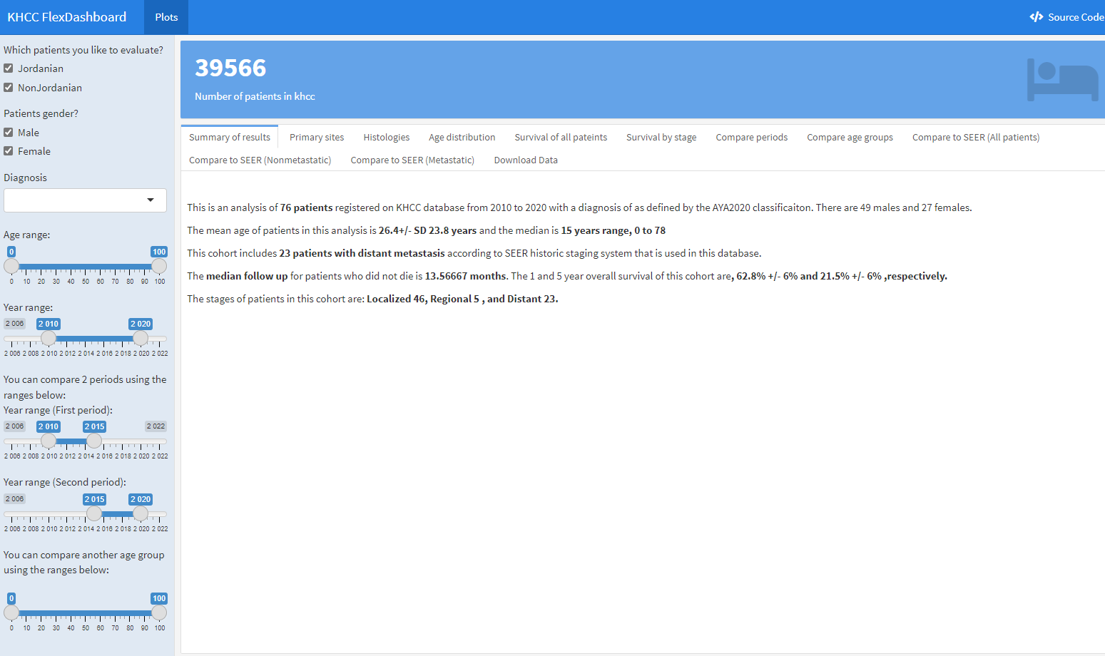
Start by selecting
Nationality
Sex
Diagnosis
Age range
Year range

Slide 3
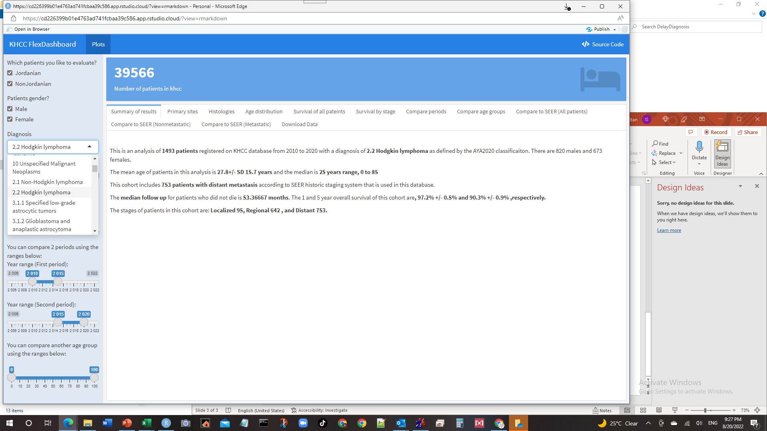
A drop-down list with all AYA classifications of diseases.
This is a simple classification that lumps many sites/histologies.
We created a code to convert all our diagnoses to AYA for simplicity.
AYA provides a common language between adults and pediatrics.
It stands for: Adolescents and Young Adults classification.

Slide 4
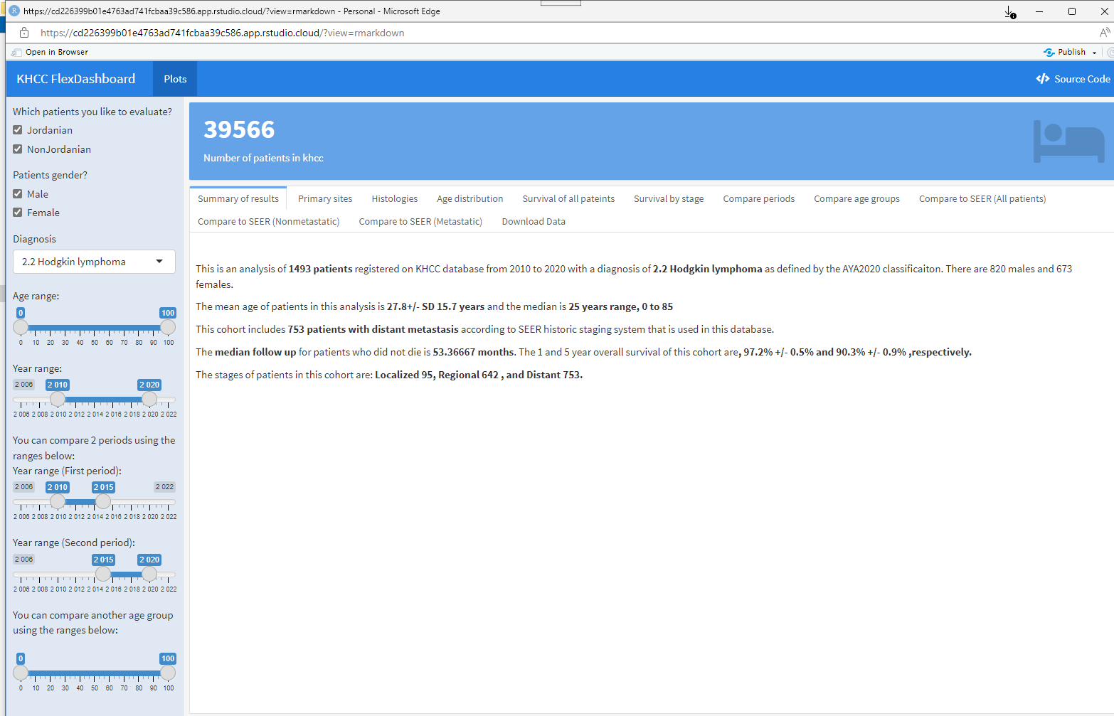
You then get a summary of all patients you selected based on nationality, gender, age, and year of diagnosis. Survival estimates are calculated using Kaplan Meier curves. You can use this data for your abstract with no reservation.

Slide 5
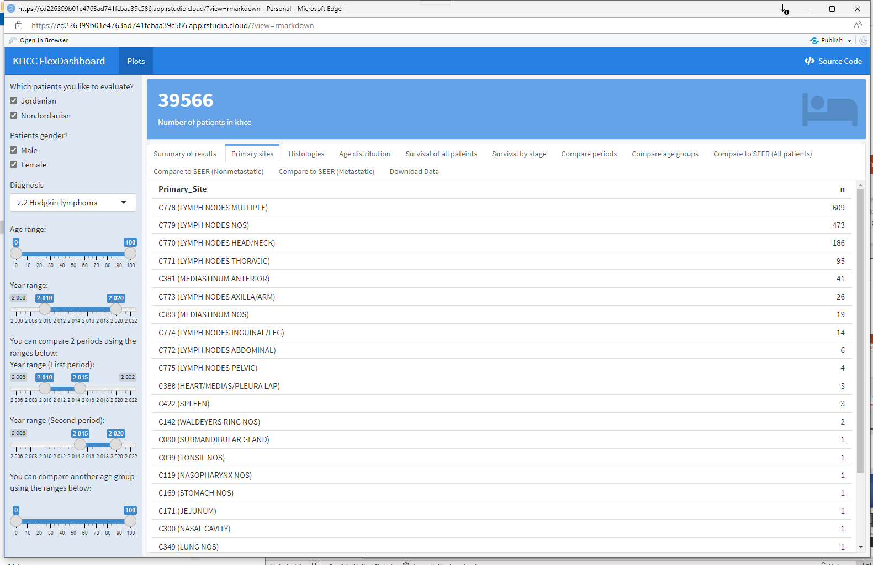
Show all primary sites for this AYA

Slide 6
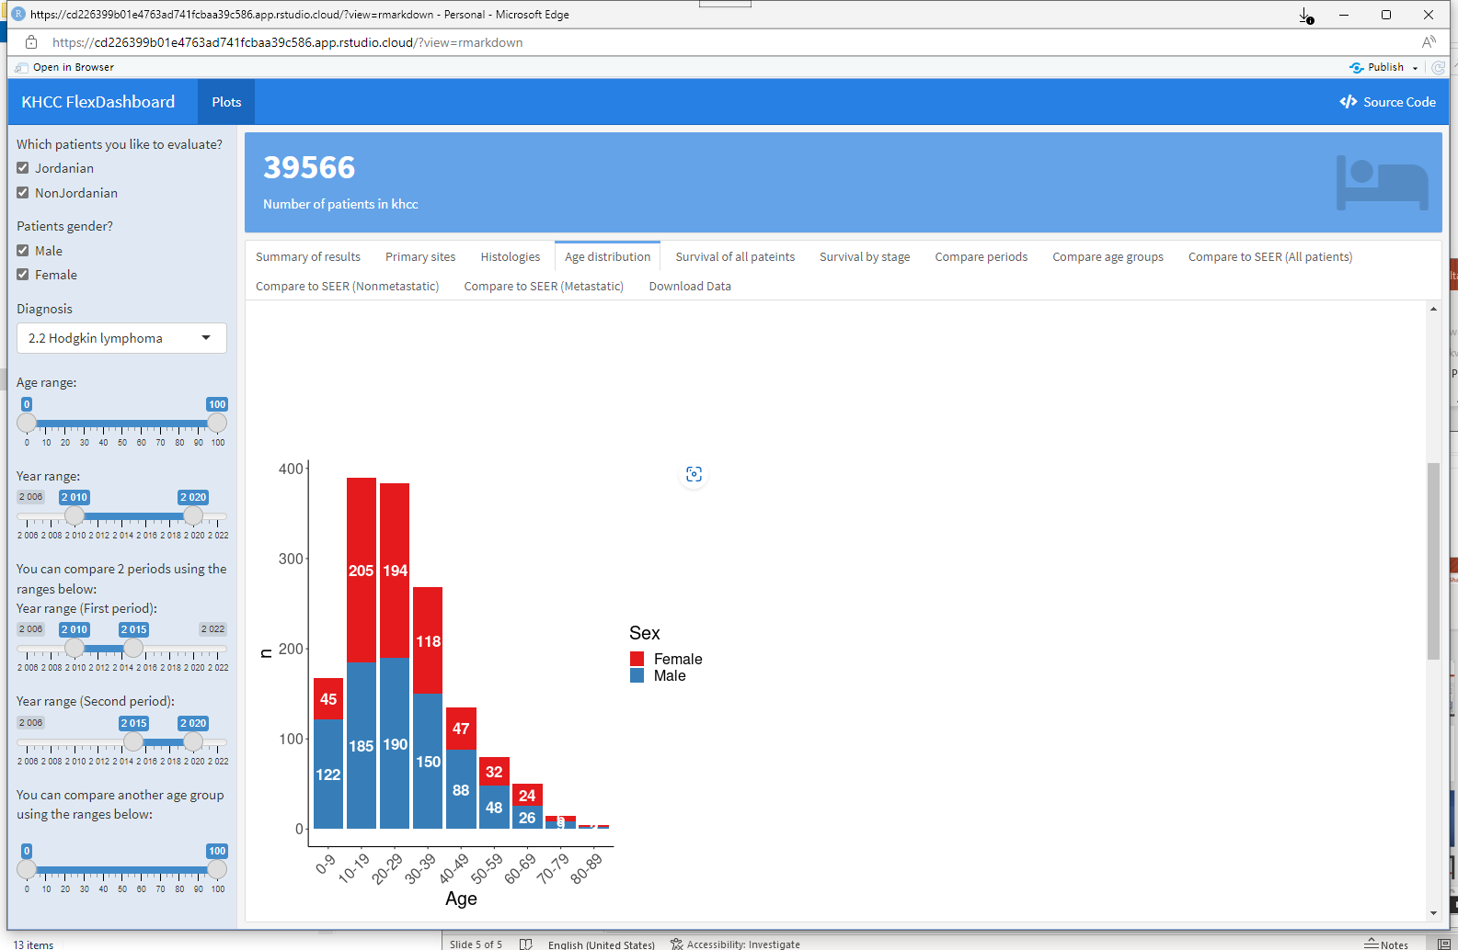
Age distribution of selected patients is provided in a table and figures.

Slide 7
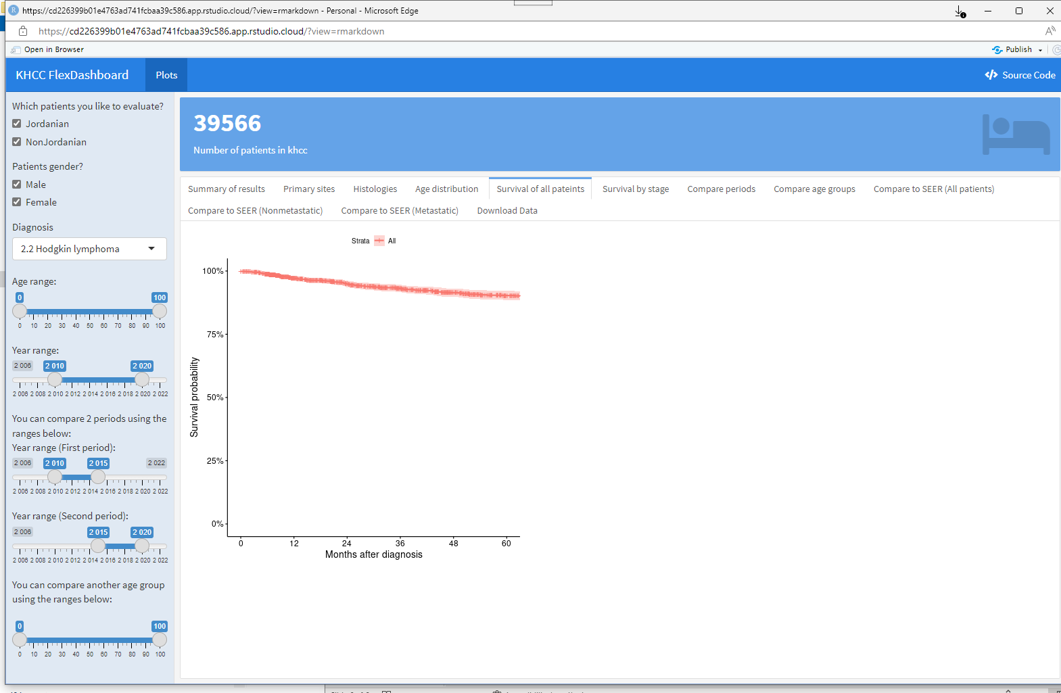
Publication quality KM curves are provided. Feel free to copy and use in your publication.

Slide 8
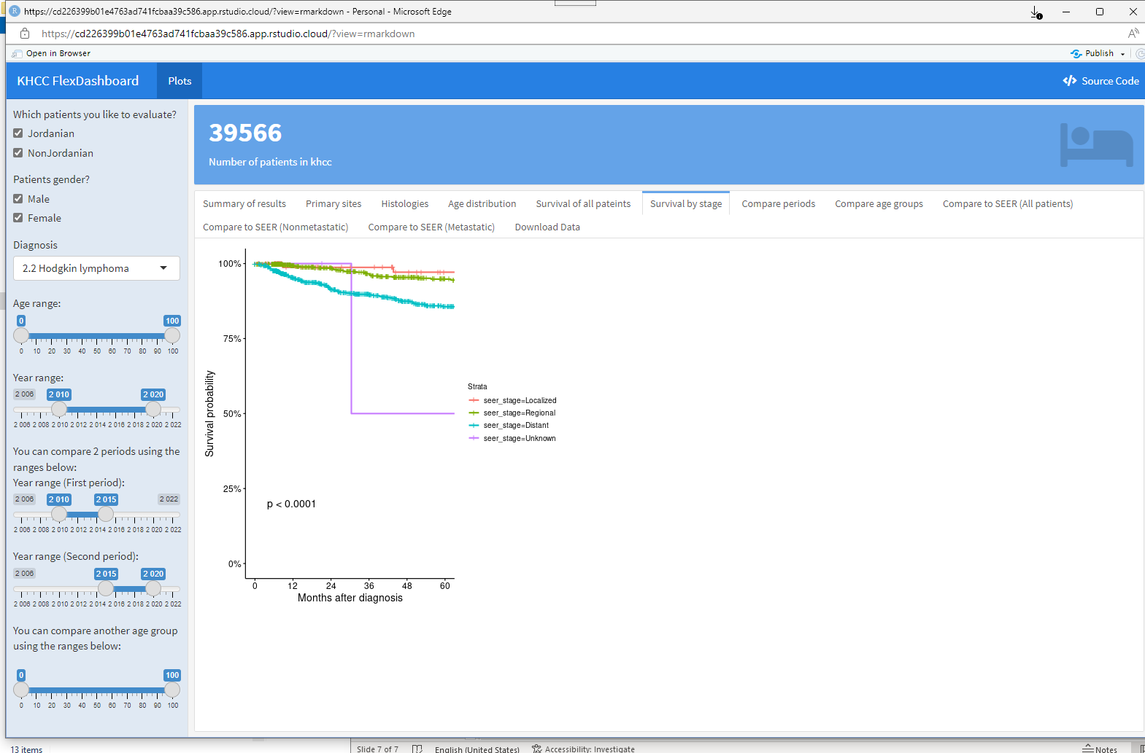
Survival by SEER stage
Soon by TNM as well.
P value is calculated using log-rank test

Slide 9
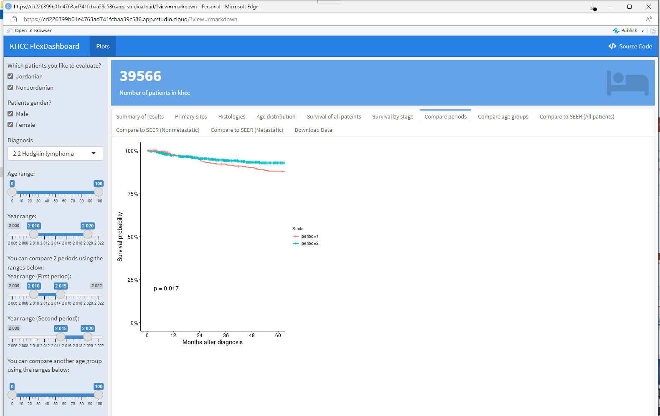
Change in outcome according to selected periods. This can help you if you want to study the impact of a procedure or medication that was used at the center during a specific period.

Slide 10

You can also compare outcomes for patients in different age groups.

Slide 11
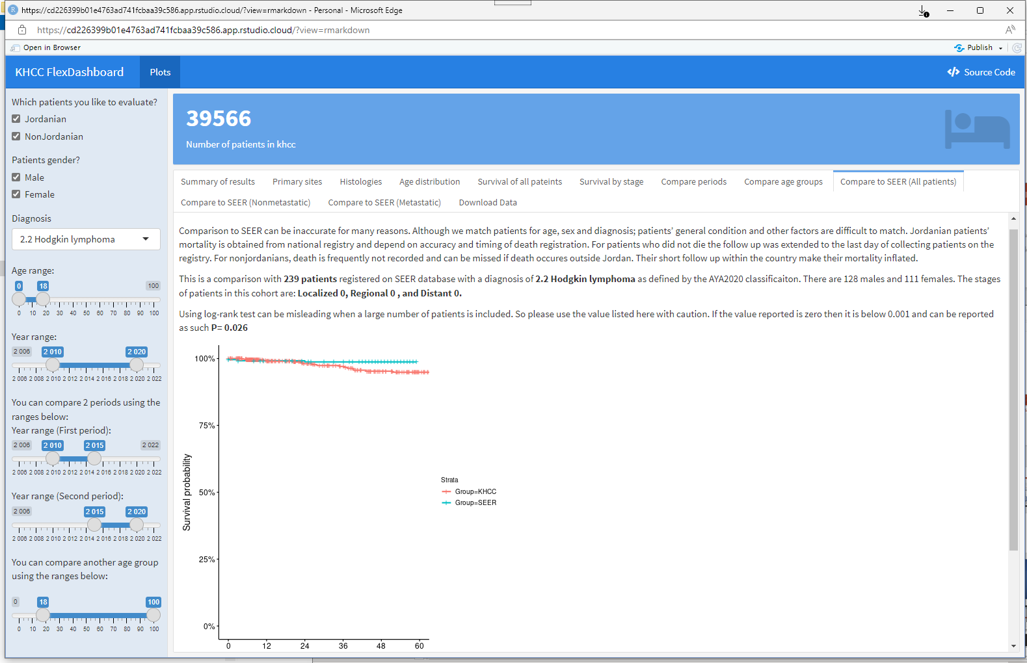
Compare the outcome to SEER data.
This can be done for metastatic or nonmetastatic patients as well.

Slide 12
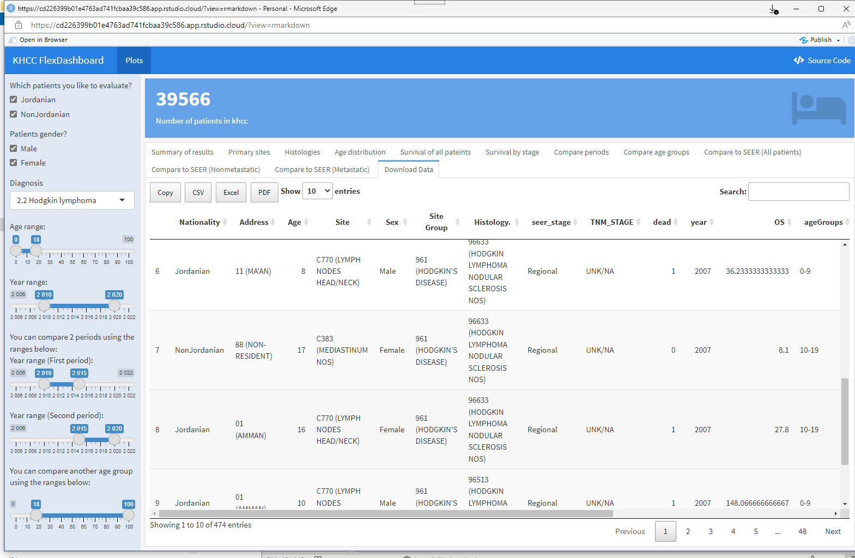
You can select data to download to do your own analysis. You cannot trace those patients to the cancer registry or medical records. But you can download a spreadsheet and have your analysis. You can search the data for a specific site or histology if you are interested.

